Slide 1
Image-Slider Project
Developed by Vishwas Verma during an internship with Unified Mentor

Slide 2
Introduction
Image Slider' is a simple image slider project implemented using HTML, CSS, and JavaScript. It allows users to browse through a collection of images with navigation options, including arrow buttons and dot navigation. Images are automatically cycled every 5 seconds with reset intervals upon manual navigation.

Slide 3
Features
• Responsive design
• Smooth transitions between images
• Arrow buttons for manual navigation
• Dot navigation for specific image selection
• Automatic image cycling every 5 seconds
• Reset intervals after manual navigation

Slide 4
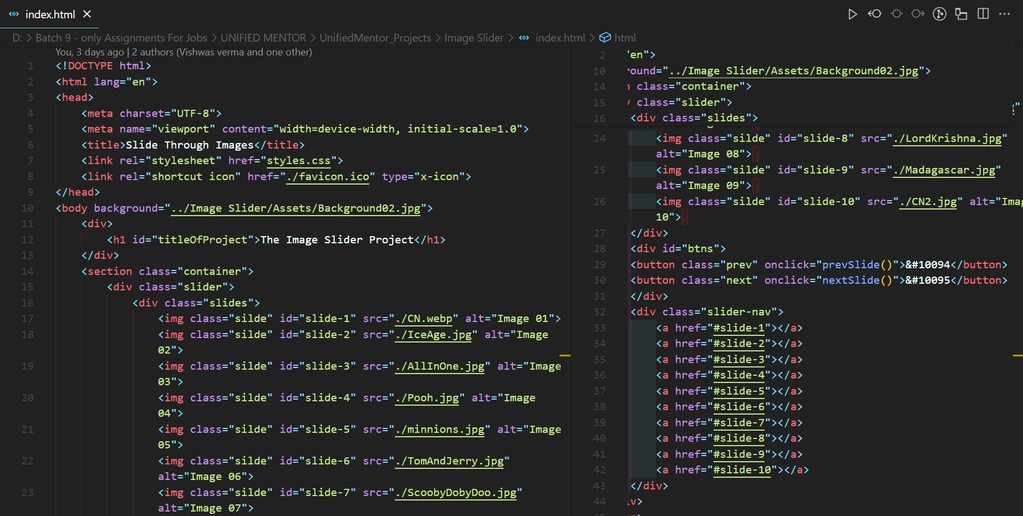
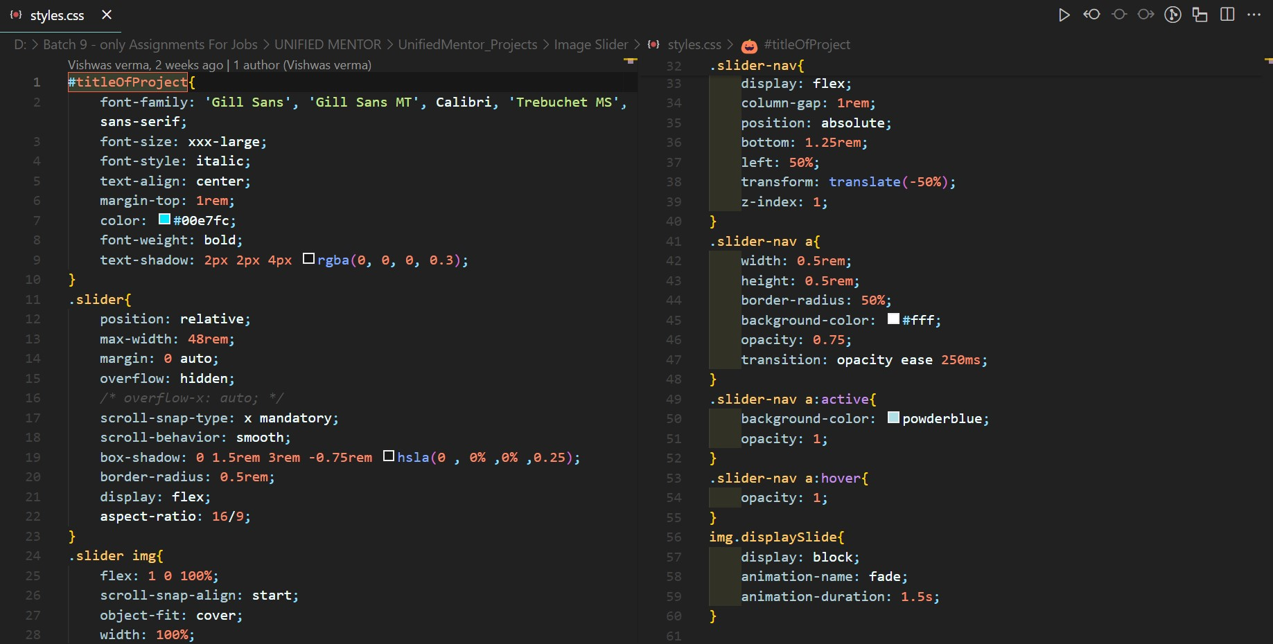
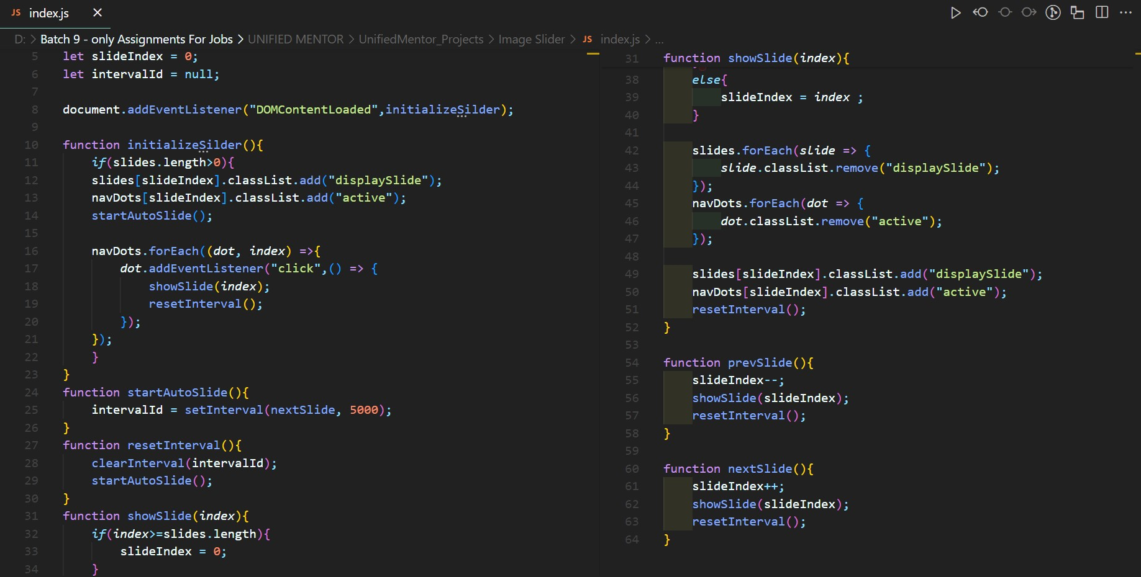
Technical Details
• Built using HTML for structure, CSS for styling, and JavaScript for functionality
• Images are displayed using the <img> tag inside a div with a 'slides' class
• JavaScript handles image cycling and user-initiated navigation

Slide 5
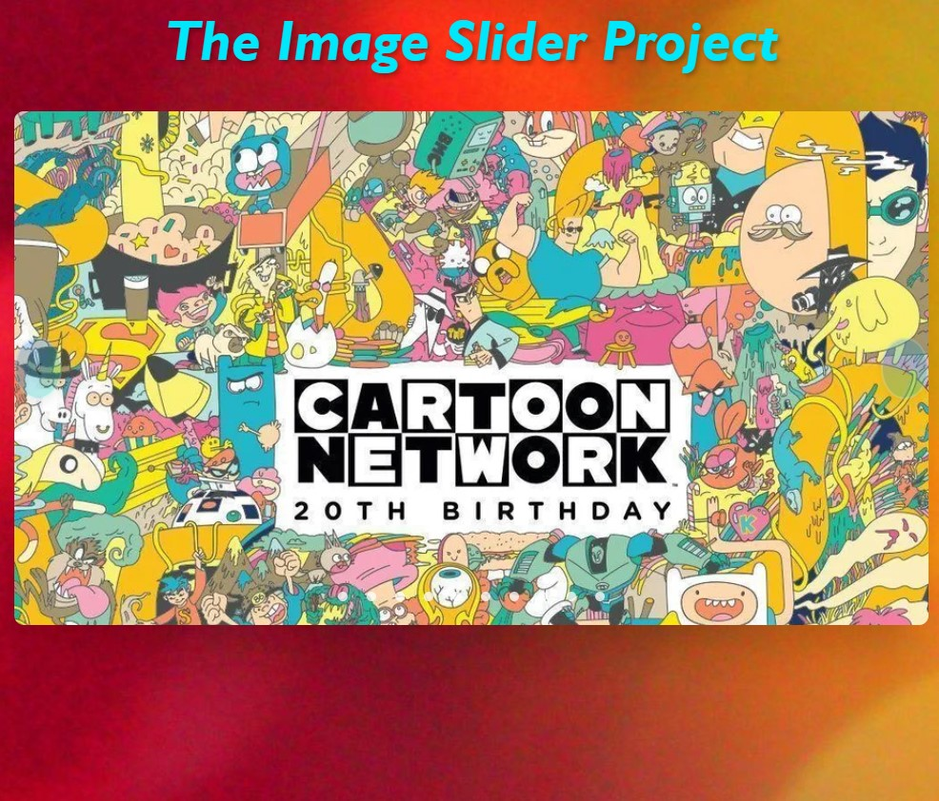
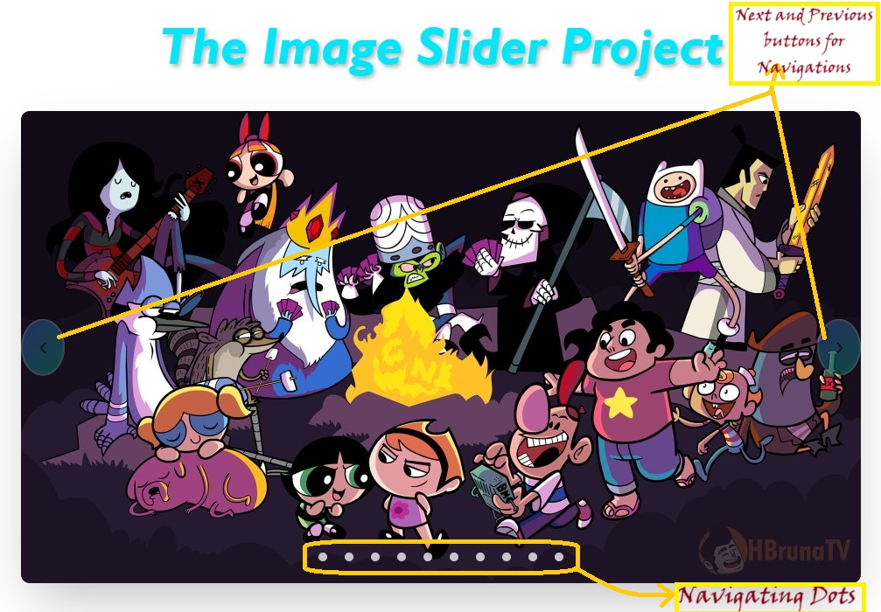
Project Demo
The image slider allows users to browse images manually using arrow buttons or dots. It also cycles images automatically every 5 seconds. The interval resets after any manual interaction, ensuring smooth and responsive navigation.

Slide 6
Code Overview
Key JavaScript functionality:
• Automatically cycles images using setInterval
• Allows users to manually navigate through images
• Resets the interval after user interactions

Slide 7
Conclusion
This project demonstrates the use of HTML, CSS, and JavaScript to create an interactive and user-friendly image slider. The source code is available on GitHub:
https://github.com/Vishverwasma
url : https://vishwas-image-slider.vercel.app/

